Slide 1
Shrinking
Spaces
Stretching
Distances
  Feras Kheirallah

Slide 2
Open Questions
What do we mean by spaces? Which spaces?
Are these spaces tied or corded to a place, group, country, system?
Who, why and how were these spaces created?
Are these spaces shrinking? Why, how, and what are the indicators?
What is the impact of the Refugee Crisis/Syrian Crisis on those “spaces”?

Slide 3
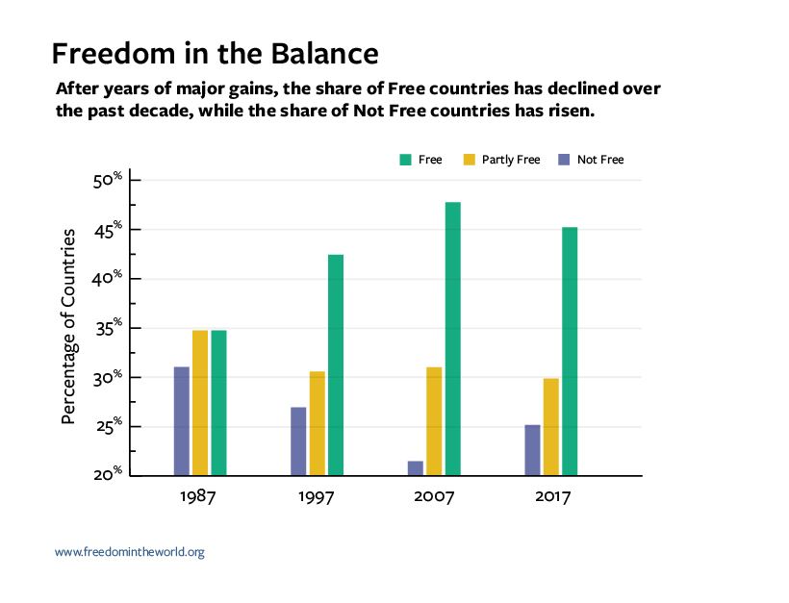
Freedom Trends in the World

Slide 4
Shrinking Spaces in Jordan & Lebanon
In general, the phenomena is a Global Trend: More than 100 governments have introduced new restrictive laws limiting the operations of civil society organizations (CSOs).
Why: Concerns over radical groups (only?)
In Jordan: Independent newspapers, civil society groups, voting avenues are severely limited.
Lebanon’s media is relatively more relaxed, however remains biased and extremely politicized.
In both countries, protesters are prosecuted in front of military courts, often detained, ill-treated and tortured. Others are subject to criminal defamation laws.

Slide 5
Shrinking Spaces:
Legislative Tools & Legal Practices
Freedom of Opinion and Expression
In Jordan,
General Statistics Law - work of research centers and CSOs - surveys, opinion polls require prior government’s
Vague articles in Anti - Terrorism Law - individuals’ rights to hold the state accountable for its decisions is hence limited.
State Security Court - tool of repression at the hands of the executive.
General Intelligence Directorate (GID) - whose director is appointed by the King - operates without any oversight.
In Lebanon, the penal code criminalizes libel and defamation of public officials, authorizing imprisonment of up to one year. Detainees are released after signing a “document of submission”.
Military courts – s. State Security Court Jordan

Slide 6
Shrinking Spaces:
Legislative Tools & Legal Practices
Right to Organize
In Jordan, the Society Law and Labor Law – limits the right to form associations, trade unions, and employer unions, e.g. employees in the public sectors.
Societies are prohibited from conducting political activities or having any political objectives.
The Labor Law grants the minister concerned the right to dissolve the associations' executive boards and to assign temporary alternative boards.
Society Law: registration of societies is mandatory.
The Penal Code: unregistered societies are illegal, individuals who conduct activities for such unregistered groups or become members thereof are subject to a penalty of up to two years’ imprisonment.

Slide 7
Freedom Rating

Slide 8
Civil Liberties

Slide 9
Political Rights

Slide 10
Freedom of the Press
Amid all the financial, political and sectarian pressure, Lebanon ranks with an aggregate score of 56/100 surpassing most Arab countries in the region.
Standing at 68/100, Jordan suffers from restrictive laws with little hope for reforms.

Slide 12
Political Schizophrenia…
This text is being SELF CENSORED
For National Security Reasons please move to the next slide!

Slide 13
Digital Activism in Jordan
According to the Internet World Stats IWS, Jordan has 8,700,000 Internet users in Dec/2017, 87.8% of the population.
Cyber Crime Law and its amendments: A serious affront to freedom of the press and a decisive move to censor the internet in Jordan.
Internet users can face a jail term of no less than 3 months and a maximum fine of JOD 2,000 (US$ 2,800), if they are found guilty of defamation on social media or online media outlets.
In practical terms, this means journalists face harsher penalties online than in print media, since the Press and Publications Law prohibits the jailing of journalists. They may be tried for printing articles if those articles appear online.
Authorities have become more proactive in issuing and enforcing gag orders to news sites, often blocking them for failing to adhere to strict editorial guidelines. Self-censorship remains pervasive, particularly around the royal family and Islam.
Significant gains in changing some laws for civil society in Jordan are often balanced out with further restrictions and legal loopholes that eventually supersede the amended laws.
No significant difference in freedom of the net over time between Lebanon and Jordan

Slide 14
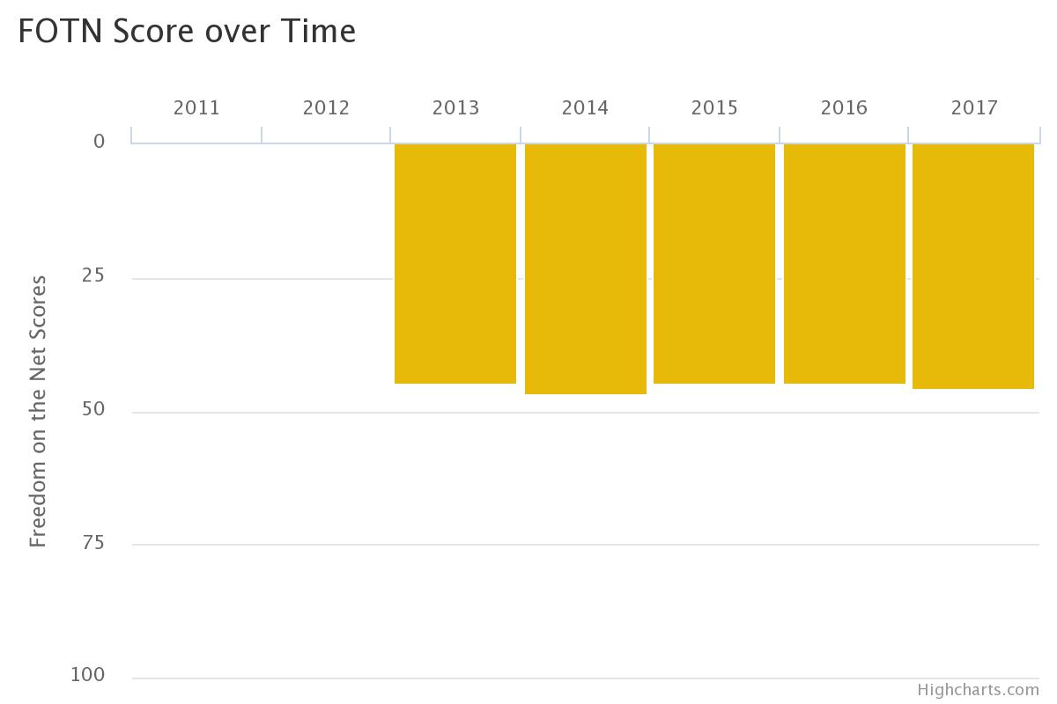
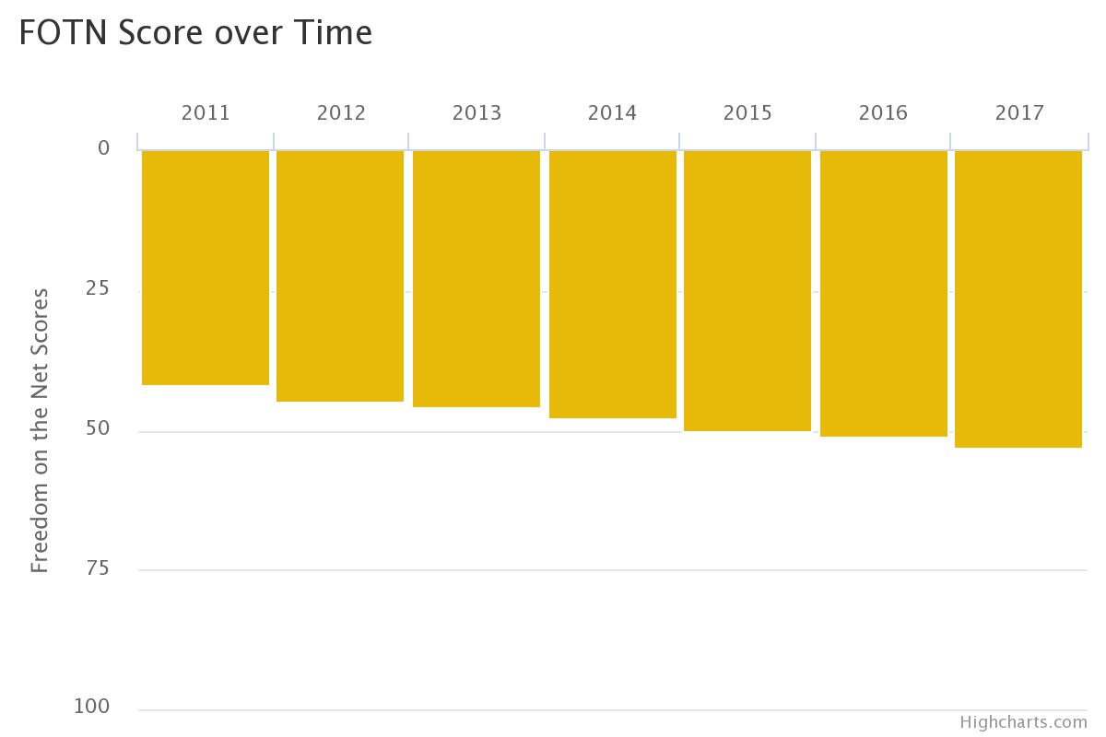
Freedom of the Net
Lebanon
Jordan
0 = Most Free ; 100 = Least Free

Slide 15
Shrinking Spaces:
Who is to blame?
Citizens that “misuse” their rights? States that have duties to protect national security and its existence? Geo-political incidents that are threatening societies and the leftovers of nation states?
The West that pushed for democratization and freedoms without creating safety nets to ensure no “Political Apostasy” is to take revenge?
REFUGEES and the impact of their tragedy on politics, economy and social fabrics? Burden vs. opportunity?
Validity of the approach: Dignity vs. security?
Shrinking alternatives: Refugee vs. oppressed citizen

Slide 16
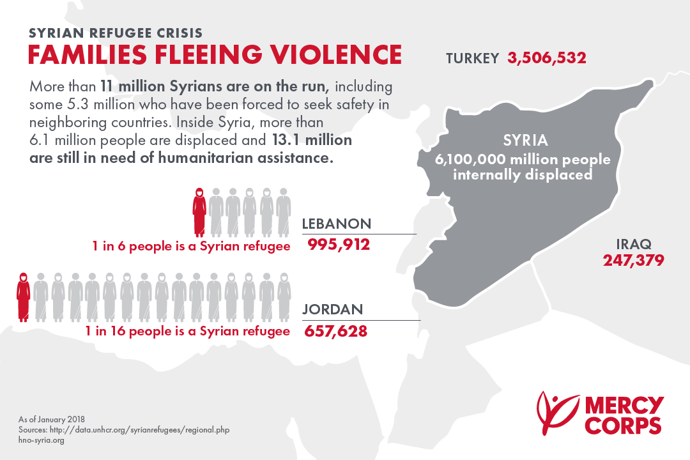
Syrian Refugees in #

Slide 17
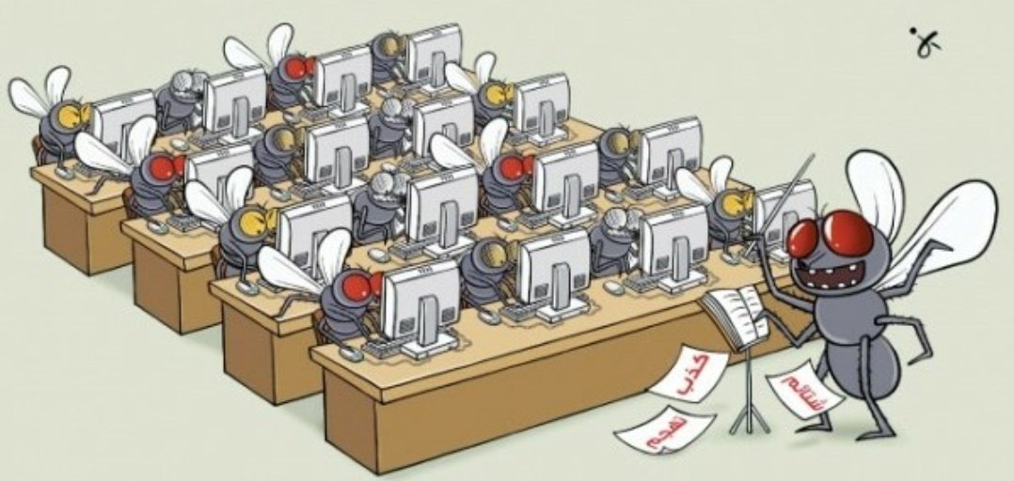
E-Flies patrolling the Cyber Space

Slide 18
Shrinking Spaces to NGOs & CSOs
Historically, civil society organizations solely focused on charitable and aid activities.
Opening to world markets and moving towards free economy, Jordan became party of a range of international conventions such as UNICCPR or ILO and HRC.
Self Censored Text
  2006 = 1800 CSO + 30 foreign NGOs
2011 = 2000 CSOs + 50 foreign NGOs
2018 = 5900 CSOs + 70 foreign NGOs

Slide 19
Features of Civil Society Org. in Jordan
Responsive to donor agendas / imposed agenda?
Some are strong and committed and demand a seat and a say in the policy making process. How does the gov. react?
Many lack skills for lobbying, negotiation and competent staff, internal accountability and transparency.
Many CSOs are only registered but not active.

Slide 20
State Response to expanding CS Space
Utilization of strategies and mechanisms to reduce chances of creating power centers or alternatives.
Legal codes and hard-pressed bureaucracy (explained)
Centralization
Infiltration: Establishing ( self censorship)
Result:
A well-organized civil society is established, which facilitates the social control of the state = liberalized Autocracy

Slide 21
Shrinking Spaces through legal codes bureaucracy
1. Law of Societies
Targets Humanitarian NGOs (Refugees), advocacy, HR, Democracy, Citizenship….
Requires Registration of CSO: State can refuse without explanation
No political objectives/goals are allowed
2. Law of public assembly
Targets Islamic Orgs, professional associations, political parties, student unions…The power to restrict demos, gatherings and meetings

Slide 22
Examples on “Other” Civil Society: RONGO-GONGO-FLANGO
Queen Rania Foundation for EDUCATION and DEVELOPMENT
Jordan River Foundation
Madrasati Initiative
Children’s Museum
Crown Prince Foundation
Queen Rania Teachers Academy
Noor Al-Hussein Foundation
Jordan Hashemite Fund for Development/ Princess Basma
Arab Thought Forum
Royal Institution for Interfaith Studies
(E.g. on Centralization) General Assembly of Voluntary Societies
= Authoritarian Upgrading (Steven Heydemann 2007)

Slide 23
Authoritarian Upgrading=Shrinking Spaces
Containing / appropriating Civil Society
Managing political contestation
Capturing the benefits of selective economic reforms
Controlling new communication technologies
Diversifying international linkages

Slide 24
How do GONGOs & Co. shrink the space?
Mislead and lobby for government policies
Mislead and channel foreign aid (donors’ darlings)
Lobbying abroad and creating state-controlled activists
Weakening legitimacy of smaller CSOs that are not meeting their commitments towards society and are not financially able to provide services
Examples: Ministers of Political Development, Speakers of the Government :Asma Khader, Jomana G, M. Momany

Slide 25
Final Conclusions- Sustaining Instability
Do the right thing, the wrong way!
Power Concentration and condensation = Shrinking Spaces to Act and React = No Public Reflected Policy is in place!
Absolute Power = Absolute Corruption (35 Billion Debt/18.5% unemployment, 20% under poverty line)
States control the space (see 17) and public freedoms that were originally established through international commitments.
States weakened PP and its CSO affiliates.

Slide 26
Answering Open Questions!
Space: a continuous area or expanse which is free, available, or unoccupied
the dimensions of height, depth, and width within which all things exist and move
the amount of paper used or needed to write about a subject
the freedom to live, think, and develop in a way that suits one
Shrinking Spaces: Yes, the worst about it is the shrinking of our humanity!

